Slide 1



Slide 2

S3 Summary - Basics
S3 is Object-based
Not suitable to install an operating system or running a database on it.
Files can be from 0 bytes to 5TB.
There is unlimited storage.
Files are stored in buckets
S3 is universal namespace.
https://my-bucket.s3.amazonaws.com/puppy.png
s3://mybucket/puppy.jpg
Read after write consistency for PUT of new objects. (as soon as upload, we can read/access)
Eventual Consistency for overwrite PUT and DELETE ( can take some time to propagate)

Slide 3
S3 Summary - Basics
S3 storage classes:
S3-Standard: durable, immediately available, frequently accessed
S3-IA: durable, immediately available, infrequently accessed
S3-One Zone IA: Same as IA. however data is stored in single availability Zone only
S3-Intelligent Tiering:- Automatically moves your data to most cost-effective tier bases on how frequently you access each object
Glacier - Archived data, Optimized for data that is infrequently accessed, and it takes minutes to hours to restore
Deep Glacier - Archived data, AWS S3’s lowest cost storage class where retrieval time of 12 hours acceptable.

Slide 4
S3 Summary - Basics
Core fundamentals of s3 object:
Key(name)
Value(data)
Version ID
Metadata
Sub-Resources
- Bucket specific config
- Bucket policies, access control list
- Cross Origin Resource Sharing
- Transfer acceleration
Successful upload from CLI generate a HTTP 200 status code
You can turn on MFA Delete

Slide 5
S3 Summary - Security
By default, all newly created buckets are PRIVATE.
You can set up access control to your buckets using:
Bucket Policies – applied at bucket level.
Access control lists – applied at an object level.
S3 buckets can be configured to create access logs, which log all requests made to the 3 bucket. These logs can be written to another bucket.

Slide 6
S3 Summary - Encryption
In Transit:
SSL/TLS
At Rest:
Server-Side Encryption:
S3 Managed Key - SSE-S3
AWS Management Service, Managed Keys, SSE-KMS
Server-Side Encryption with Customer Provided Keys SSE-C
Client-Side Encryption
If you want to enforce the use of encryption for your files stored in S3, use an S3 Bucket Policy to deny all PUT requests that don’t include the x-amz-server-side-encryption parameter in the request header.

Slide 7
S3 Summary - CORS
Cross Origin Resource Sharing (CORS):
Used to enable cross origin access for your AWS resources
E.g. S3 hosted website accessing javascript or image files located in another S3 bucket
By default, resources in one bucket cannot access resources located in another
To allow the we need to configure CORS on the bucket being accessed and enable access for the origin (bucker) attempting to access
Always use the s4 website URL, not the regular bucket URL:
https://my-bucket.s3-website-eu-west-1.amazonaws.com
https://s3-website-eu-west-1.amazonaws.com/puppy.png

Slide 8
S3 Summary - CloudFront
Edge Location - This is the location where content is cached you can case content that you're trying and can also be written. Separate to an AWS region or availability zone.
Origin - This is just the origin of all the files that the content delivery network will distribute. Origin can be S3, EC2 instance, Elastic load balance or Route 53.
Distribution - This is the name given to content distribution network, which consists of a collection of edge locations
1. Web distribution : - Used for Web sites (HTTP/HTTPs)
2. RTMP (Realtime messaging protocol ): Used for streaming audio video, data over the Internet or Flash multimedia content. (Adobe Real Time Messaging Protocol)

Slide 9
S3 Summary - CloudFront
Edge locations are not just read only - you can WRITE them too. (i.e. PUT an object on to them)
CloudFront edge Location are utilized by S3 transfer acceleration to reduce latency for S3 uploads.
Objects are cached for the life of the TTL (Time to Live)
You can clear cached objects, but you will be charged.

Slide 10
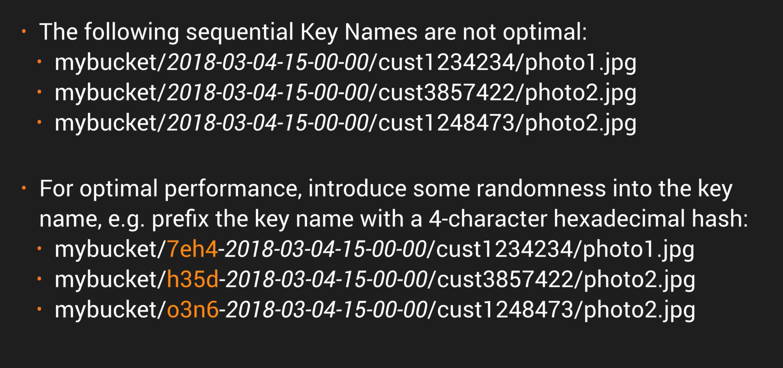
S3 Summary – Performance Optimization
Remember the 2 main approaches to Performance Optimization for S3:
GET-intensive Workloads : Use cloud front Content
Mixed Request Type Workload : Avoid sequential key names for S-3 objects. Instead use a random prefix like a hex hash at the front of the key name to prevent multiple objects from being stored on the same partition.
In July 2018, Amazon announce a massive increase in S3 performance.
3500 PUT requests per second
5500 get requests
This new increased performance negate the previous guidance to randomize your object key names to achieve faster performance
This means logical and sequential naming pattern can now be used without any performance implication

Slide 11
Thank you

